Slide 1

CANCER CELL ANALYSIS
Ben Christian, Craig Gabel, Eric Helander, Jeffrey Kropelnicki

Slide 2
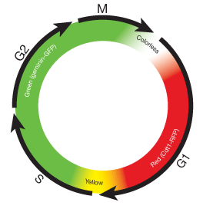
DATASET
Dataset provided by Michael Levin from Tufts University
14,202 (1328 x 1048) cancer cell images totaling 21.3GB
Images were captured every 5 minutes over a 62-hour period
Divided into 6 different captures with each of them containing 3 different color channels (green, red, and colorless)
The color channels are determined
by the phase-dependent nature of
replication licensing factors Cdt1 and Geminin.
Also referenced as the
Fluorescent Ubiquitination-based
Cell Cycle Indicator (FUCCI)
https://www.thermofisher.com/us/en/home/life-science/cell-analysis/cell-viability-and-regulation/cell-cycle/live-cell-imaging-of-cell-cycle-and-division.html

Slide 3
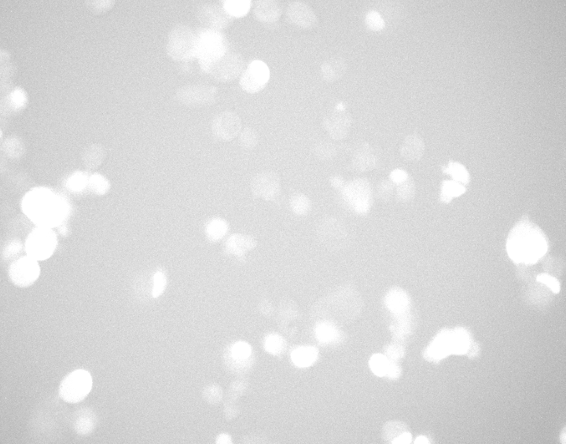
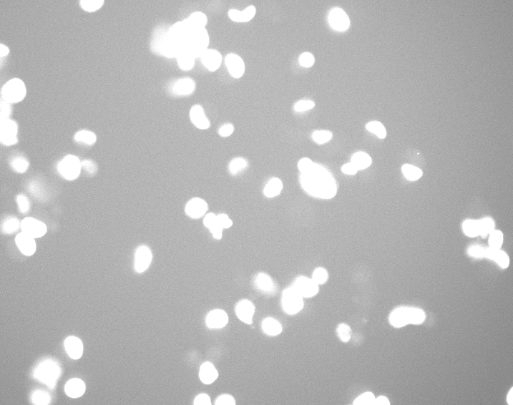

EXAMPLE IMAGES
Green Color Channel
Red Color Channel
Plain Light

Slide 4
PROBLEM
Develop an algorithm that can predict when a cancer cell’s Fluorescent Ubiquitination-based Cell Cycle Indicator (FUCCI) will change.

Slide 5
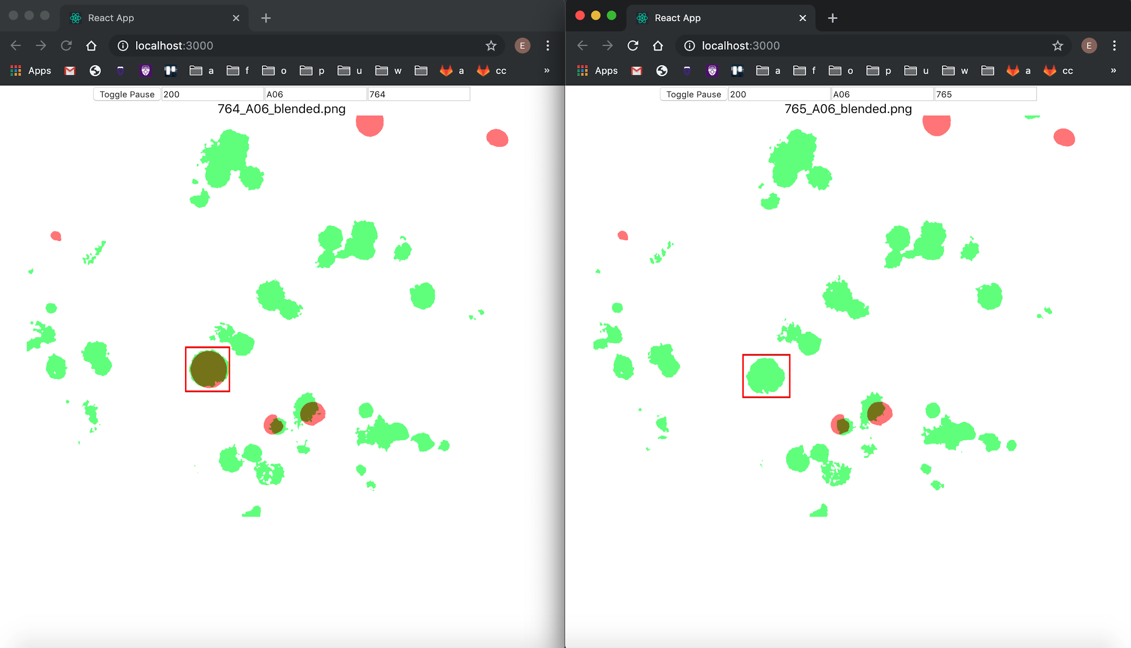
Example FUCCI Change (blended image)

Slide 6
APPROACH
Identify the cells within an image using object detection and apply a mask to the original images.
Combine the green color channel masked images and the red color channel masked images together to create a combined image.
There was some debate on whether we should use the original images to train the LSTM, however, it was significantly easier for us to visualize what was happening between images when the green channel and red channel images were combined and labeled appropriately
Use a LSTM RNN on the combined images to analyze the movement and relationships between the cells and attempt to predict future frames
By predicting future frames we hoped to be able to see if the predicted frames would contain changes to the Fluorescent Ubiquitination-based Cell Cycle Indicator (FUCCI), in another words would the LSTM RNN be able to capture the conditions necessary for a change to occur.

Slide 7
CELL OBJECT DETECTION
Decided to use Detectron2 for object detection and masking
Just released in Oct. 2019
Detectron2 is Facebook AI Research's next generation software system that implements state-of-the-art object detection algorithms. It is a ground-up rewrite of the previous version, Detectron, and it originates from maskrcnn-benchmark. https://medium.com/analytics-vidhya/detectron2-by-facebook-ai-research-is-here-b666987ad8b8
Requires Dataset along with COCO Annotations

Slide 8
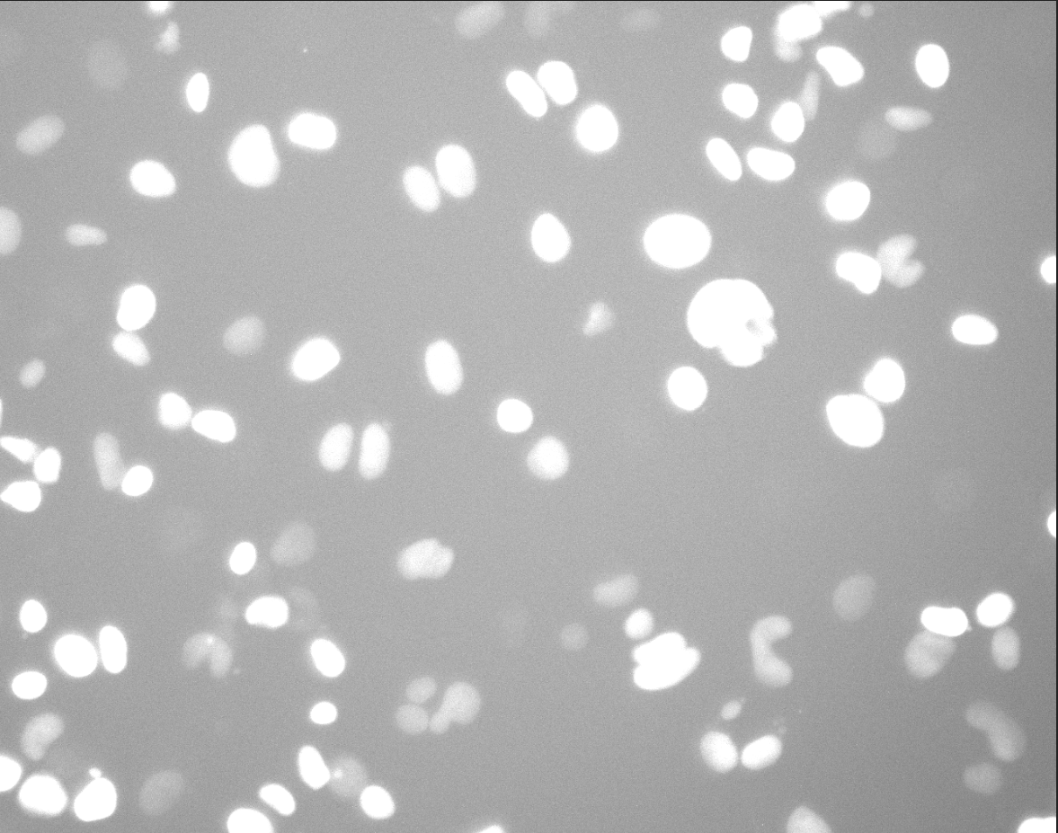
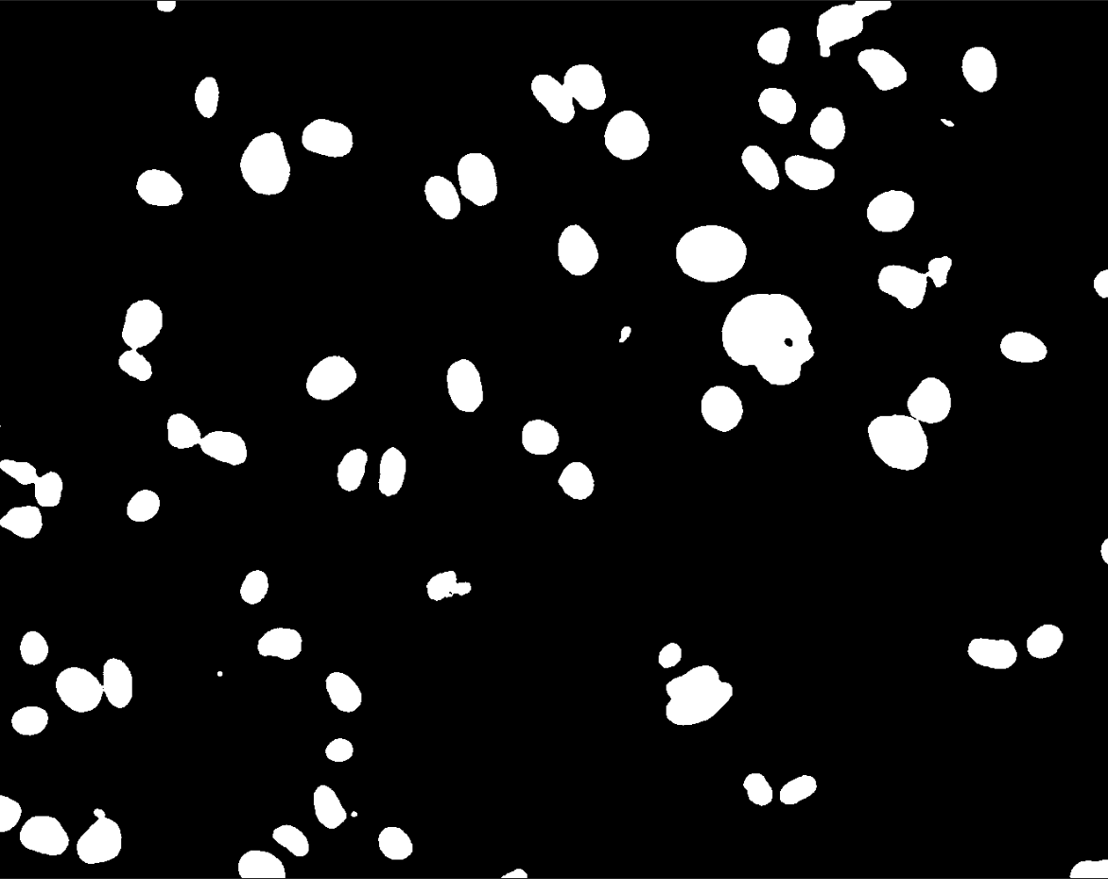
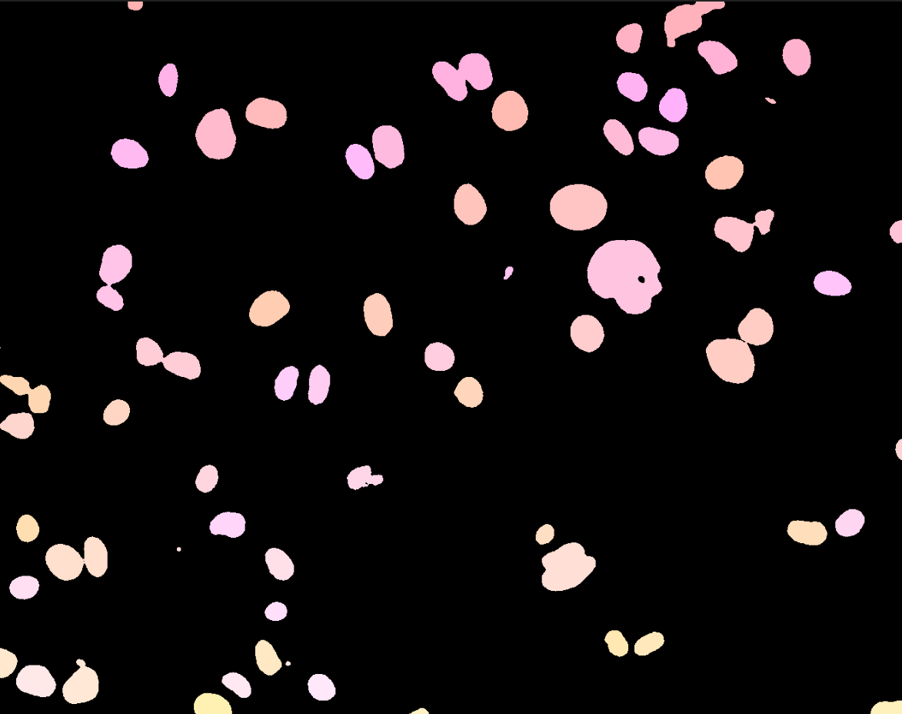
ANNOTATING IMAGES
Wrote program in Python to create annotations
Packages: Pillow (PIL), Scikit-image
Program Steps
Smooth Image using bilateralFilter and medianBlur
Change Image to Black and White using threshold
Label images using label (captures information such as boxes, and pixels belonging to instances)

Slide 9
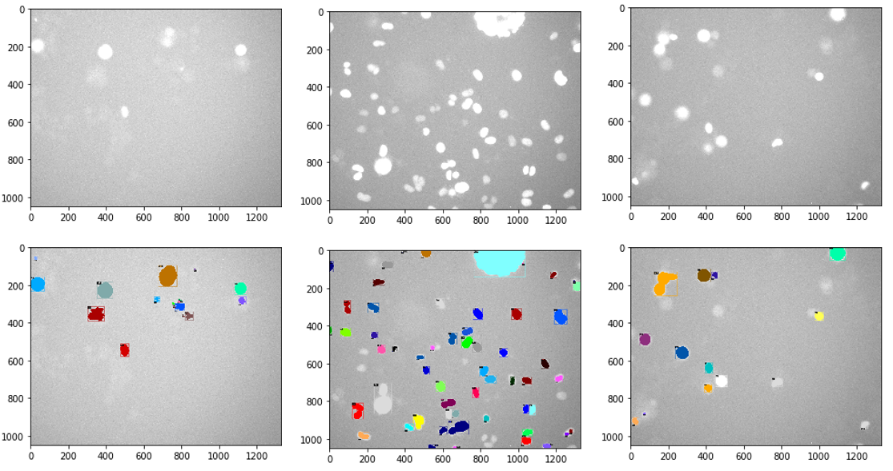
VISUALIZATION OF ANNOTATIONS

Slide 10
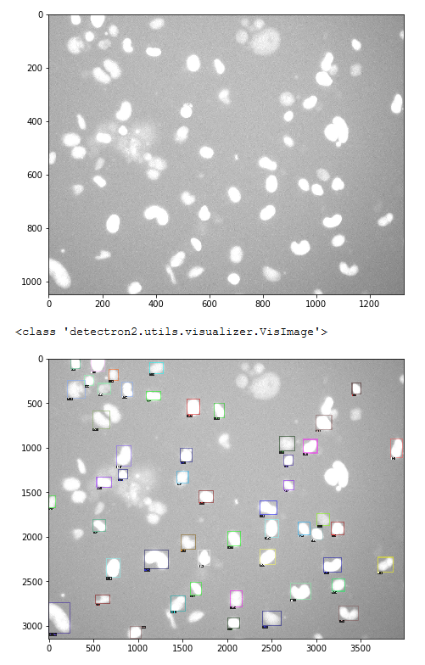
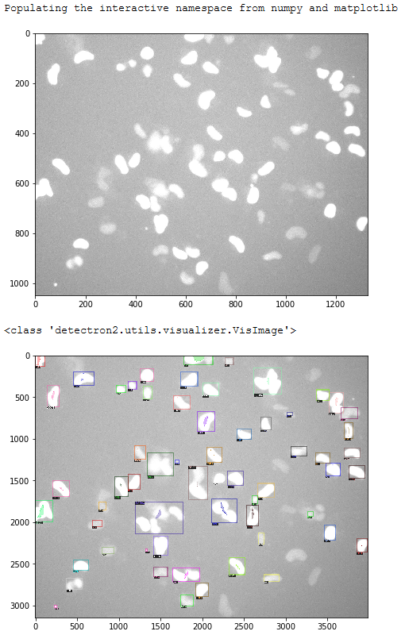
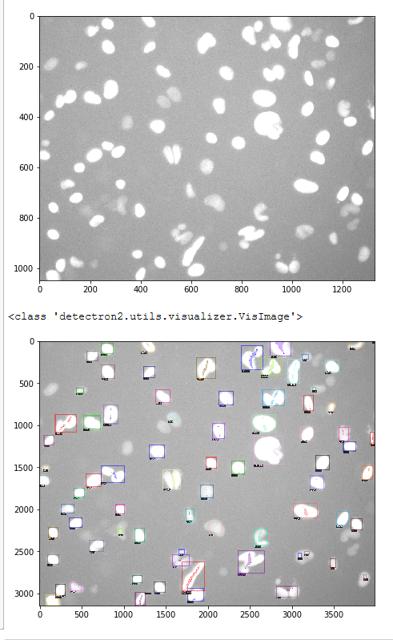
CELL OBJECT DETECTION RESULTS
300 Epochs, LR 0.00025
mask_rcc_R_50FPN
10000 Epochs, LR 0.00025
mask_rcc_R_50FPN
20000 Epochs, LR 0.00025
mask_rcc_R_101FPN
Total Loss: 0.738
Loss CLS: 0.057
Loss_box_reg: 0.147
Loss_mask: 0.291
Loss_rpn_cls: 0.016
Loss_rpn_lov: 0.213

Slide 11
CELL OBJECT DETECTION CHALLENGES
Object Detection worked well
Masking was a challenge
Adjusted Epochs
Adjusted Learning Rates
Adjusted Network Architectures
Lastly Adjusted image sets for training and validation.
Some of the earlier images and later images in the data set were harder for the annotation program to annotated (due to extra white in the images)
Took a subset that was visually checked and determined to look good, however, the results were very similar
In the end since the annotation program worked well in most cases decided to use the images that generated as the input for the future frame prediction

Slide 12
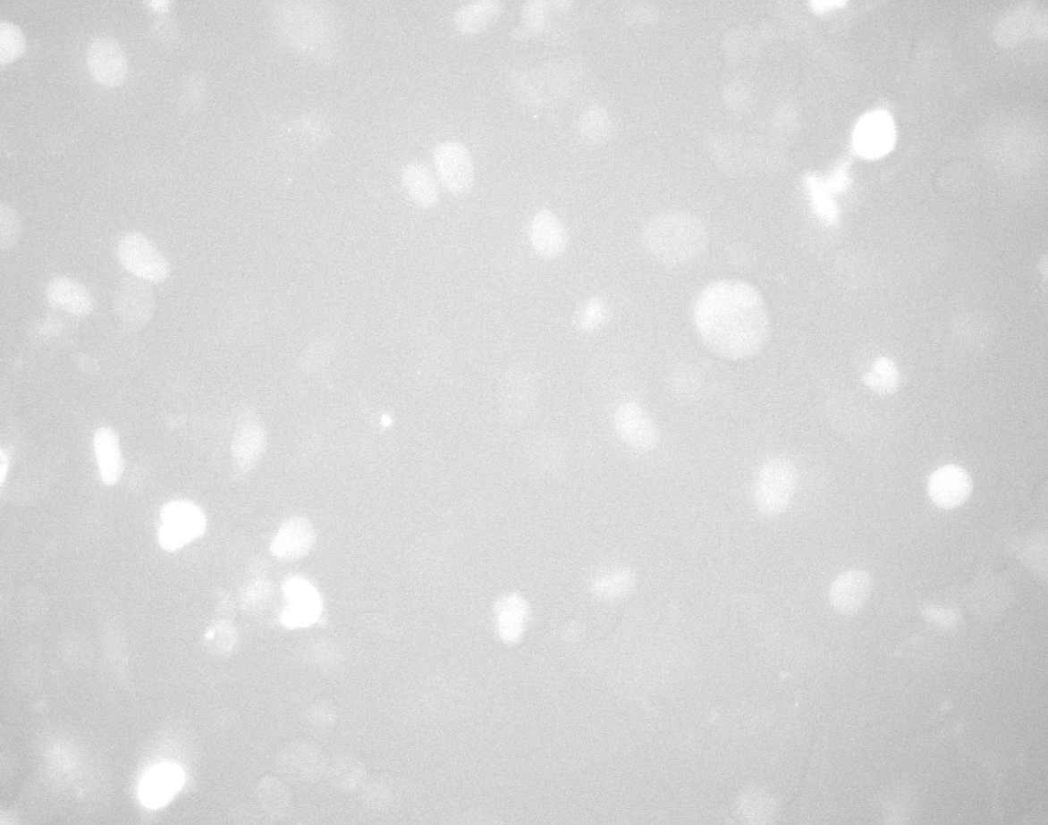

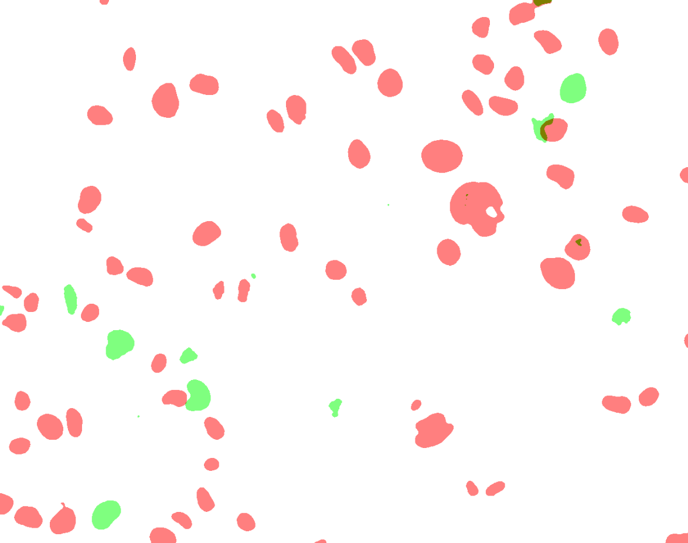
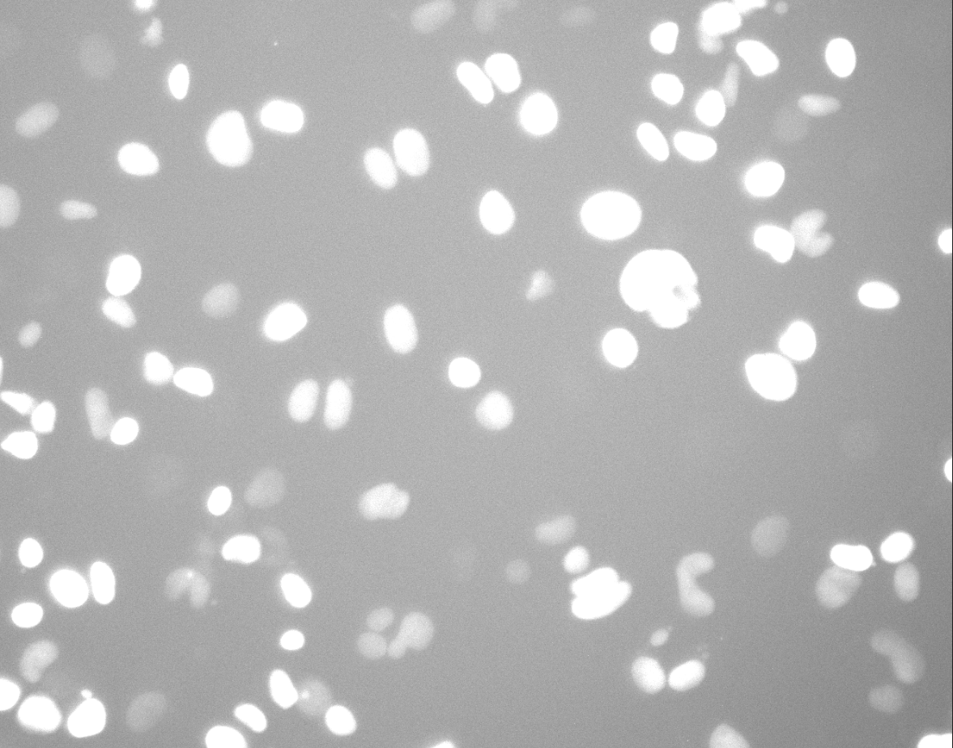
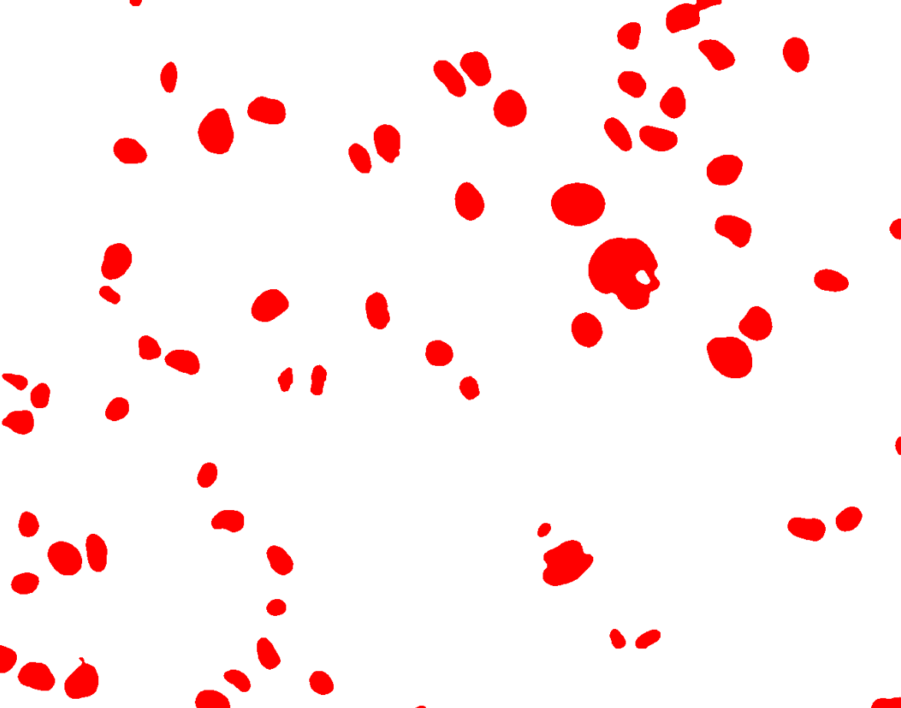
COMBINED IMAGE CREATION

Slide 13
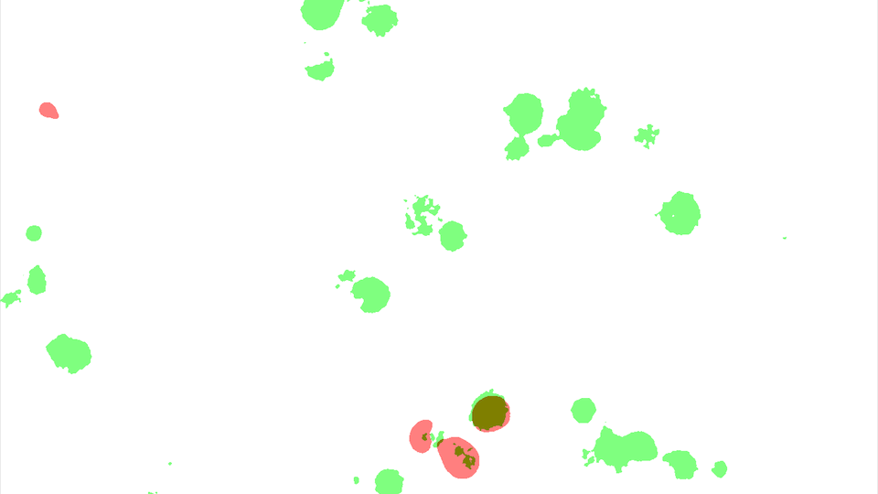
COMBINED IMAGE VIDEO

Slide 14
FUTURE FRAME PREDICTION:
Model Architecture
LSTM
­ Sequence length = 15
M-to-1 approach
­Total sequences = 765
Compressed image dimension
­120 * 95 * 3
­
4 LSTM layers
­Filters = 90
­Kernel size = 3x3
Conv2D layer (output layer)
­Filters = 3
­Kernel size = 3x3
­Activation = relu

Slide 15

FUTURE FRAME PREDICTION 1.5: Prediction Methods
First method
­Predicted frames are never used as predictors
Meaning we can only ever predict 1 more frame than we actually have
Second method
Predicted frames are rotated into the predictor sequence
Meaning we can theoretically predict as far into the future as we want

Slide 16
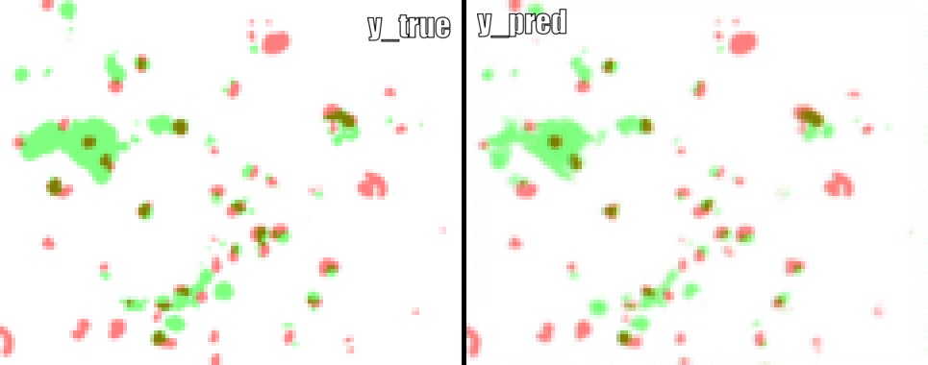
FUTURE FRAME PREDICTION 2:
Results, Method 1

Slide 17
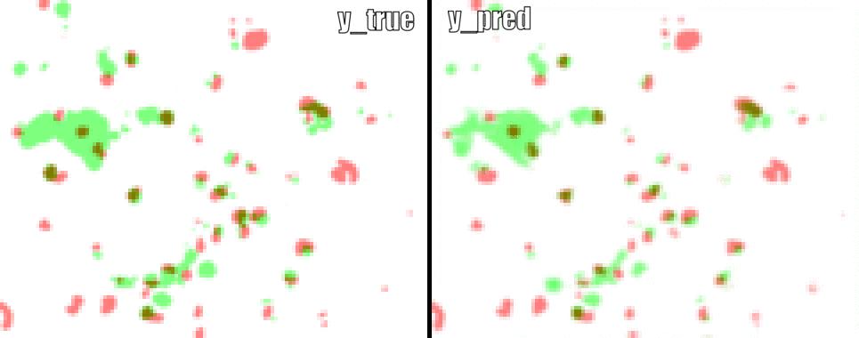
FUTURE FRAME PREDICTION 2:
Results, Method 2

Slide 18
FUTURE FRAME PREDICTION 3:
Challenges
Training Time
Epochs
1 or 2 during code development
50 to 100 for prediction (10 hour training time)
­Memory
Image resolution compressed from 1328*1048 to 120*95
Only ~15% of images used during training
LSTM filter count and depth were restricted
­
The goal was to prepare ourselves to use a cloud solution that might handle all of our uncompressed images while using a more complex model.
Instance | Epochs | Run Time Minutes | Cost Per Hour | Notes | GPU Type | Memory and CUDA cores
p3.8xlarge | 2 | Resource Exhausted Error | $12.24 | Tried to run full image 1328-1048 this instance did not enough resources | Four NVIDIA Tesla V100 GPUs | 64GB GPU Memory and 20,480 CUDA Cores

Slide 19
FUTURE FRAME PREDICTION ON AWS
Instance | Epochs | Run Time Minutes | Cost Per Hour | Time Per Epoch | GPU Type | Memory and CUDA cores
Home | 2 | 3.78 |  | 96 Seconds Per Epoch | 2080 SUPER | 8GB GPU Memory and 3072 CUDA Cores
Home | 10 | 16.28 |  | 96 Seconds Per Epoch
p3.2xlarge | 2 | 1.93 | $3.06 | 54 Seconds Per Epoch | One NVIDIA Tesla V100 GPUs | 16GB GPU Memory and 5,120 CUDA Cores
p3.2xlarge | 10 | 9.27 | $3.06 | 54 Seconds Per Epoch
p3.8xlarge | 2 | 1.95 | $12.24 | 52 Seconds Per Epoch | Four NVIDIA Tesla V100 GPUs | 64GB GPU Memory and 20,480 CUDA Cores
p3.8xlarge | 10 | 8.94 | $12.24 | 52 Seconds Per Epoch
p2.8xlarge | 2 | 2.02 | $7.20 | 57 Seconds Per Epoch | Eight NVIDIA GK210 | 12GB GPU Memory and 2496 CUDA Cores
p2.8xlarge | 10 | 9.23 | $7.20 | 57 Seconds Per Epoch

Slide 20
PROJECT CHALLENGES
Problem was vague, had no defined way to measure success or failure
Dataset was challenging as the red color channel was dominant over the green color channel
Dataset had periods of neither green or red color channels appearing
Lack of FUCCI changes occurring within the images
Using high-resolution images proved computationally infeasible (even with cloud computing)

Slide 21
FUTURE WORK
Continue trying to accurately mask cells within images
Try to predict more frames in the future
Using more capable computing resources
Explore other options in addition to Neural Networks
Trackpy - Trackpy is a package for finding blob-like features in video, tracking them through time, and analyzing their trajectories. It implements and extends the widely-used Crocker–Grier algorithm in Python.

